Slide 1


Introduction to Machine Learning
DBDA.X408.(33)
Instructor:
Bill Chen
UCSC Silicon Valley Extension
E: xchen375@ucsc.edu
Notes:
DBDA.X408.(33) Introduction to Machine Learning

Slide 2

Week 2
Linear Regression: General linear Models.
Model Fitting: Training/Testing/Validation.
Confusion Matrix. Receiver Operating Characteristic.
Logistic regression.
Newton's Method.
Probability Review.
Weighted Least Squares.

Slide 3
Previously we defined Machine Learning as
Question for student?
To describe the supervised learning problem slightly more formally, our goal is, given a training set, to learn a function.
h: X → Y
so that h(x) is a “good” predictor for the corresponding value of y, so that h(x) is a “good” predictor for the corresponding value of y.
For historical reason, this function h is called a hypothesis.

Slide 4
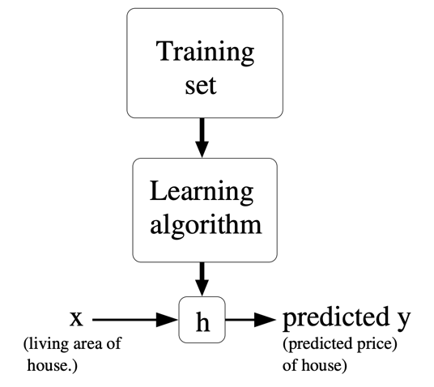
Hypothesis
Regression Problem:
When target variable is continuous, such as housing price, amount, etc.
Classification Problem:
When target variable is discrete value, such as townhouse vs house.

Slide 5
Linear Regression, Logistic Regression, Newton’s Method

Slide 6
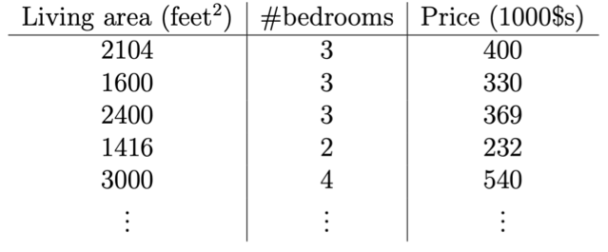
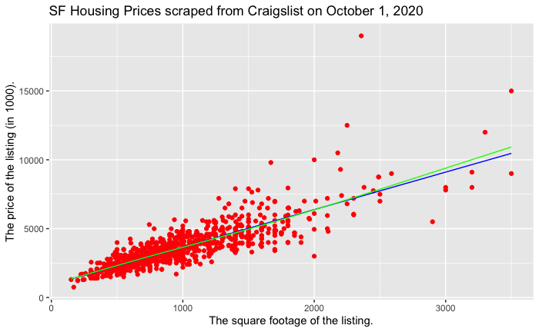
Linear Regression
To perform supervised learning, we must decide how we’re going to represent functions/hypotheses h in a computer. We can approximate y as linear function h of x
h_{θ}(x) = θ₀ + θ₁x₁ + θ₂x₂
Here, the θ_{i} ’s are the parameters (also called weights) parameterizing the space of linear functions mapping from X to Y.
h(x)
Linear Regression with one variable:
h(x) =θ₀ + θ₁x
Notes:
In general, when designing a learning problem, it will be up to you to decide what features to choose, so if you are out in Portland gathering housing data, you might also decide to include other features such as whether each house has a fireplace, the number of bathrooms, and so on. We’ll say more about feature selection later, but for now let’s take the features as given.

Slide 7

Linear Regression
Idea: choose θ₀ , θ₁ so that h_{θ}(x) is close to y for our training example:
θ₀ = 5000
θ₁ = 0
Linear Regression with one variable:
h(x) =θ₀ + θ₁x

Slide 8
Linear Regression
Idea: choose θ₀ , θ₁ so that h_{θ}(x) is close to y for our training example:
θ₀ = 2500
θ₁ = 0.5
Linear Regression with one variable:
h(x) =θ₀ + θ₁x

Slide 9
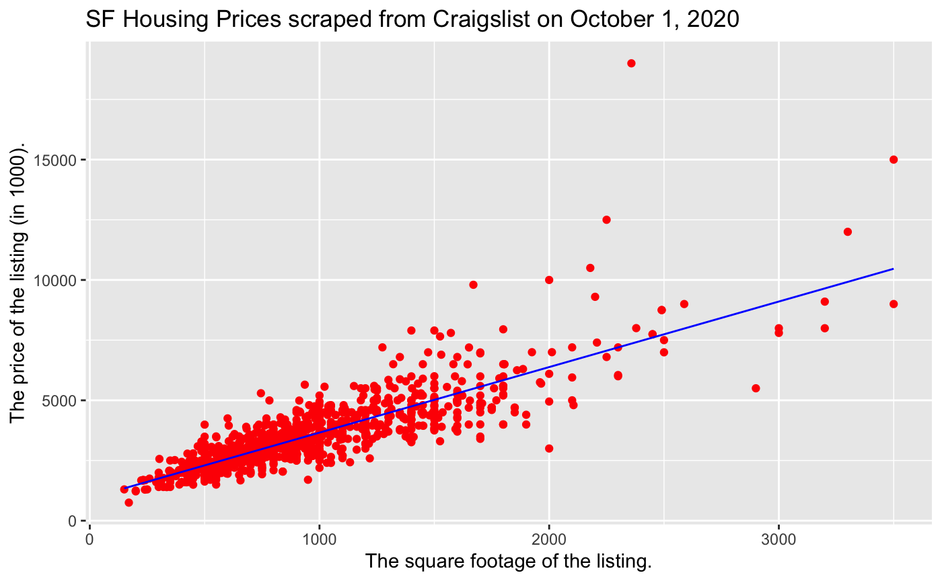
Linear Regression
Idea: choose θ₀ , θ₁ so that h_{θ}(x) is close to y for our training example:
θ₀ = 935.36
θ₁ = 2.72
Linear Regression with one variable:
h(x) =θ₀ + θ₁x

Slide 10
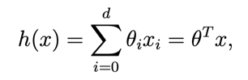
Linear Regression
We can also write the formula:
h_{θ}(x) = θ₀ + θ₁x₁ + θ₂x₂
As:
What the Machine is “learning” here?
Notes:
Now, given a training set, how do we pick, or learn, the parameters θ? One reasonable method seems to be to make h(x) close to y, at least for the training examples we have.

Slide 11
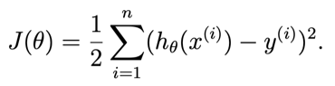
Linear Regression
One reasonable method seems to be to make h(x) close to y, at least for the training examples we have. To formalize this, we will define a function that measures, for each value of the θ’s, how close the h(x ^{(i)})’s are to the corresponding y^{(i)}’s. We define the cost function:
We want to choose θ so as to minimize J(θ).
Notes:
If you’ve seen linear regression before, you may recognize this as the familiar least-squares cost function that gives rise to the ordinary least squares regression model. l. Whether or not you have seen it previously, let’s keep going, and we’ll eventually show this to be a special case of a much broader family of algorithms.

Slide 12
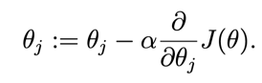
LMS algorithm
We want to choose θ so as to minimize J(θ). To do so, let’s use a search algorithm that starts with some “initial guess” for θ, and that repeatedly changes θ to make J(θ) smaller, until hopefully we converge to a value of θ that minimizes J(θ). Specifically, let’s consider the gradient descent algorithm, which starts with some initial θ, and repeatedly performs the update:
(This update is simultaneously performed for all values of j = 0, . . . , d.) Here, α is called the learning rate. This is a very natural algorithm that repeatedly takes a step in the direction of steepest decrease of J.

Slide 13
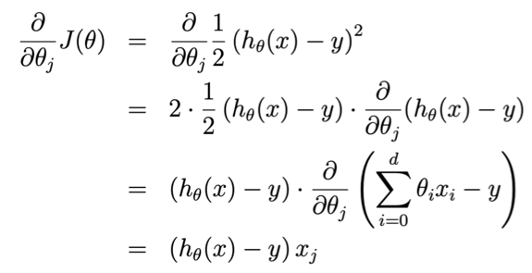
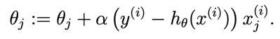
LMS update rule
For a single training example, this gives the update rule:
The rule is called the LMS update rule (LMS stands for “least mean squares”), and is also known as the Widrow-Hoff learning rule.

Slide 14
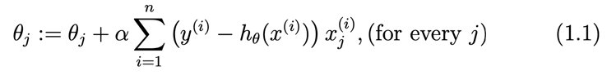
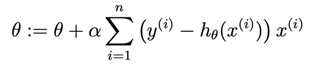
LMS update rule
The magnitude of the update is proportional to the error term (y^{(i)} - h(x^{(i)}));
Aka, the machine is learning from the “mistake”,
if we encountering a training example on which our prediction h(x^{(i)}) nearly matches the actual value of y^{(i)}, then we find that there is little need to change the parameters
in contrast, a larger change to the parameters will be made if our prediction h(x^{(i)}) has a large error (i.e., if it is very far from y^{(i)})
Repeat until convergence
Rewrite in a vector format:

Slide 15
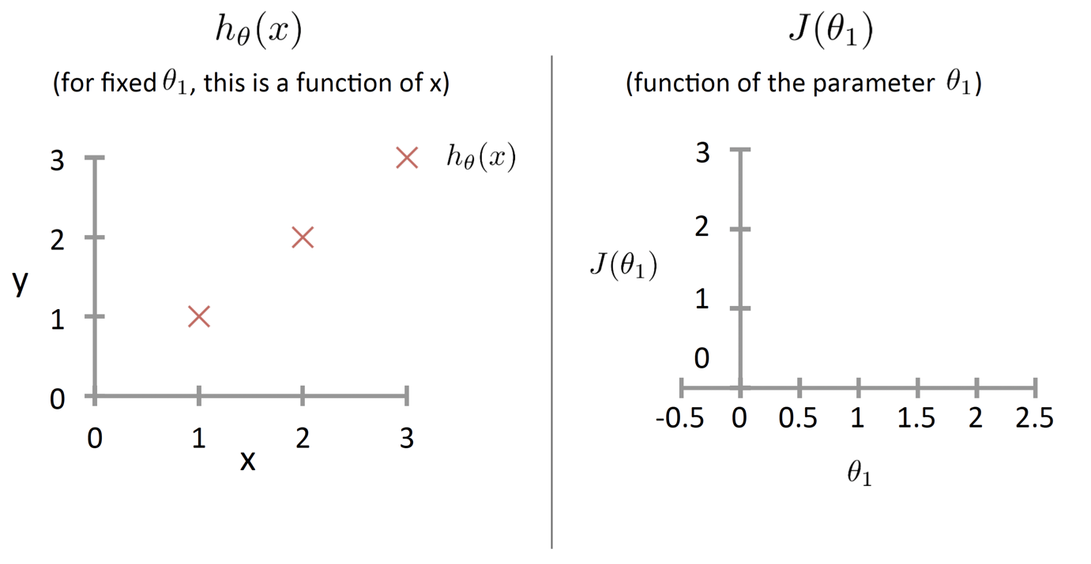
LMS update rule

Slide 16
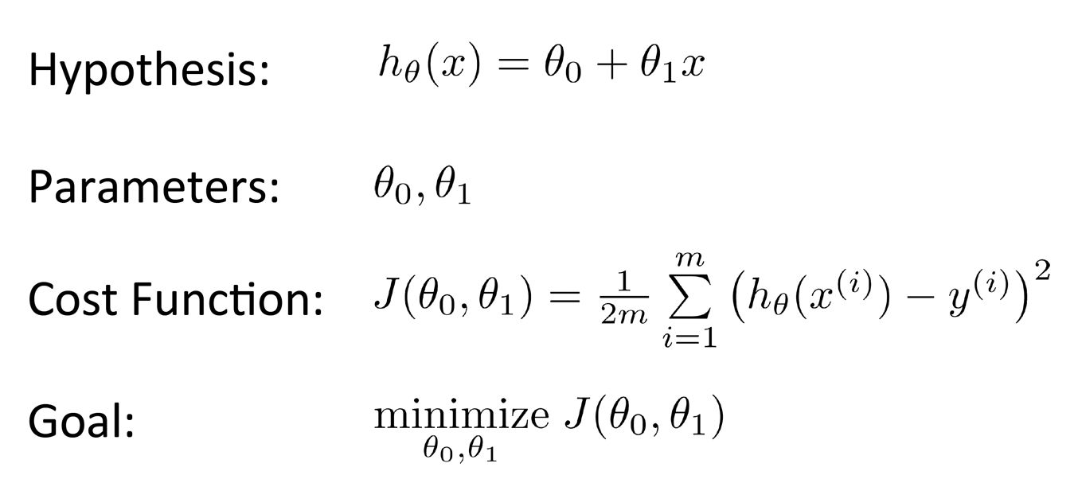
LMS update rule

Slide 17
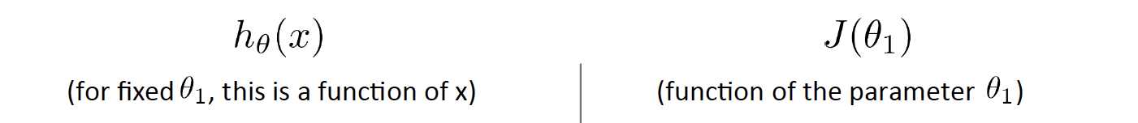
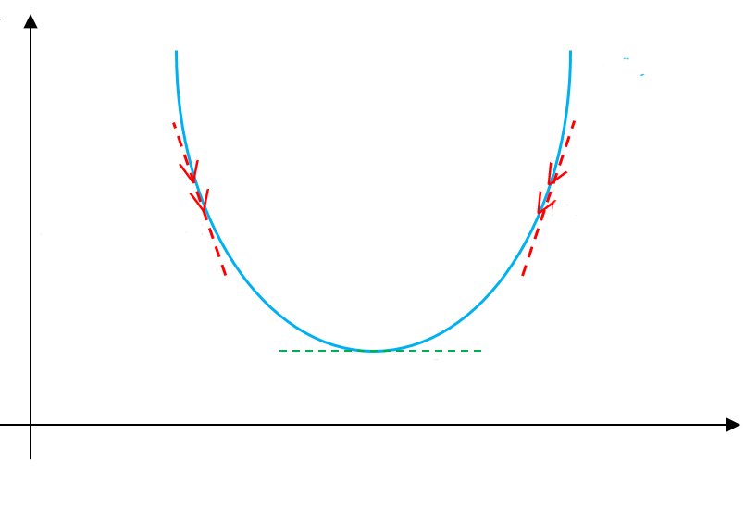
LMS update rule
J(θ₁)
⛛J(θ₁)<0
Negative gradient
⛛J(θ₁)>0
Positive gradient
minimum: ⛛J(θ₁)=0

Slide 18
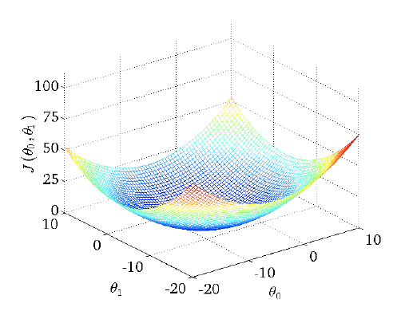
LMS update rule

Slide 19
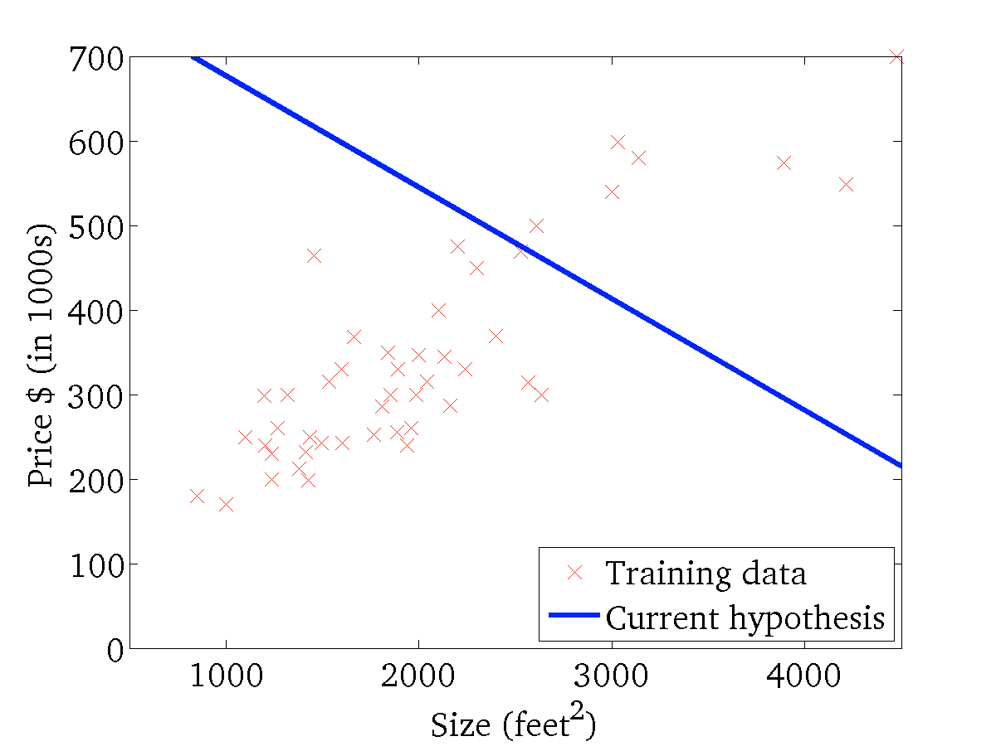
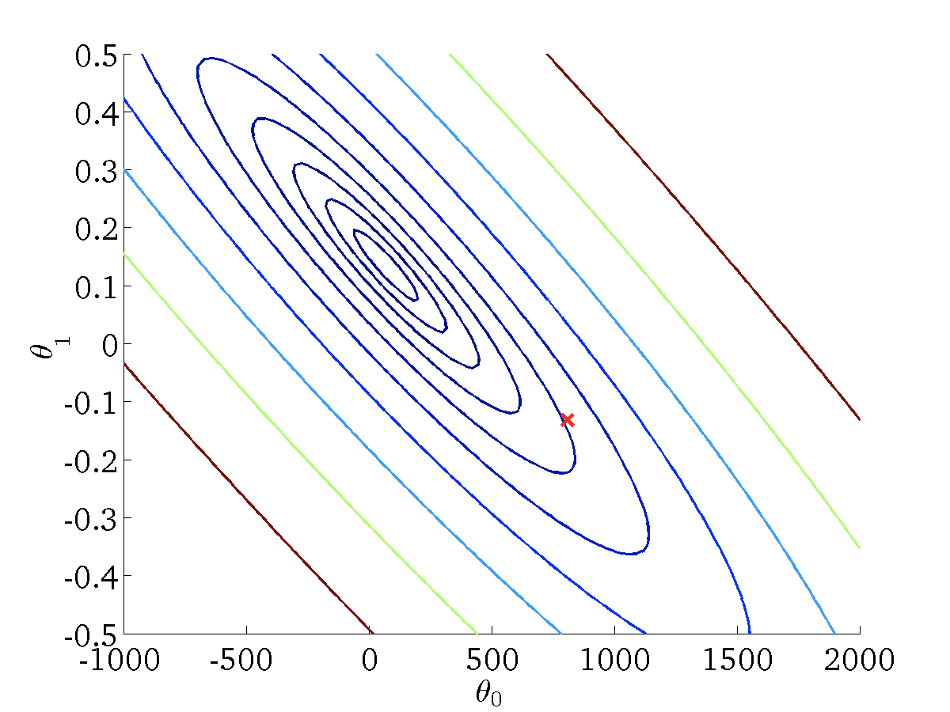
LMS update rule

Slide 20
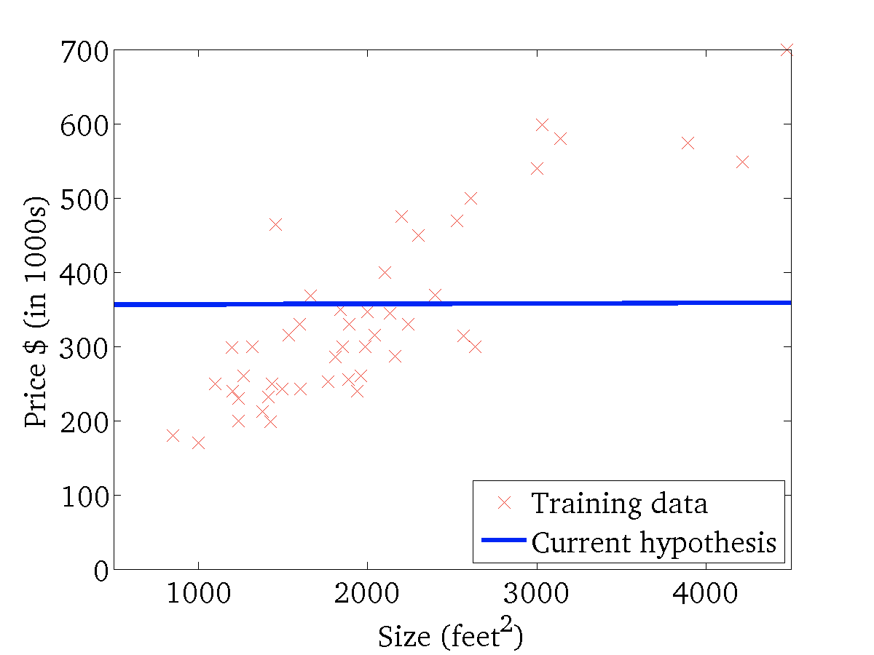
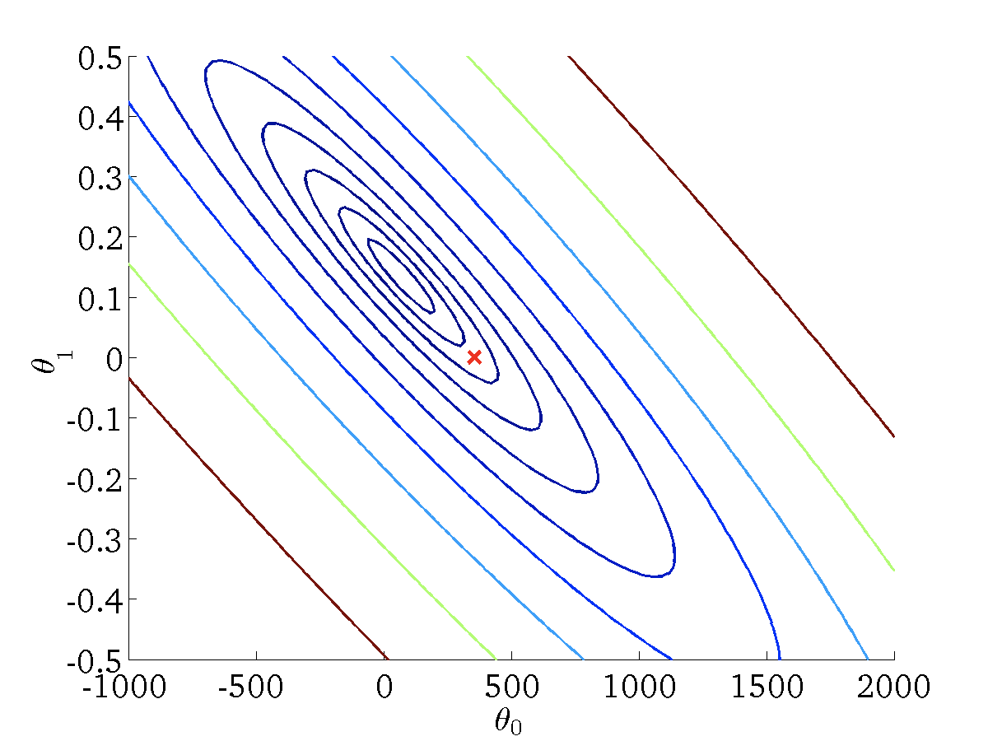
LMS update rule

Slide 21
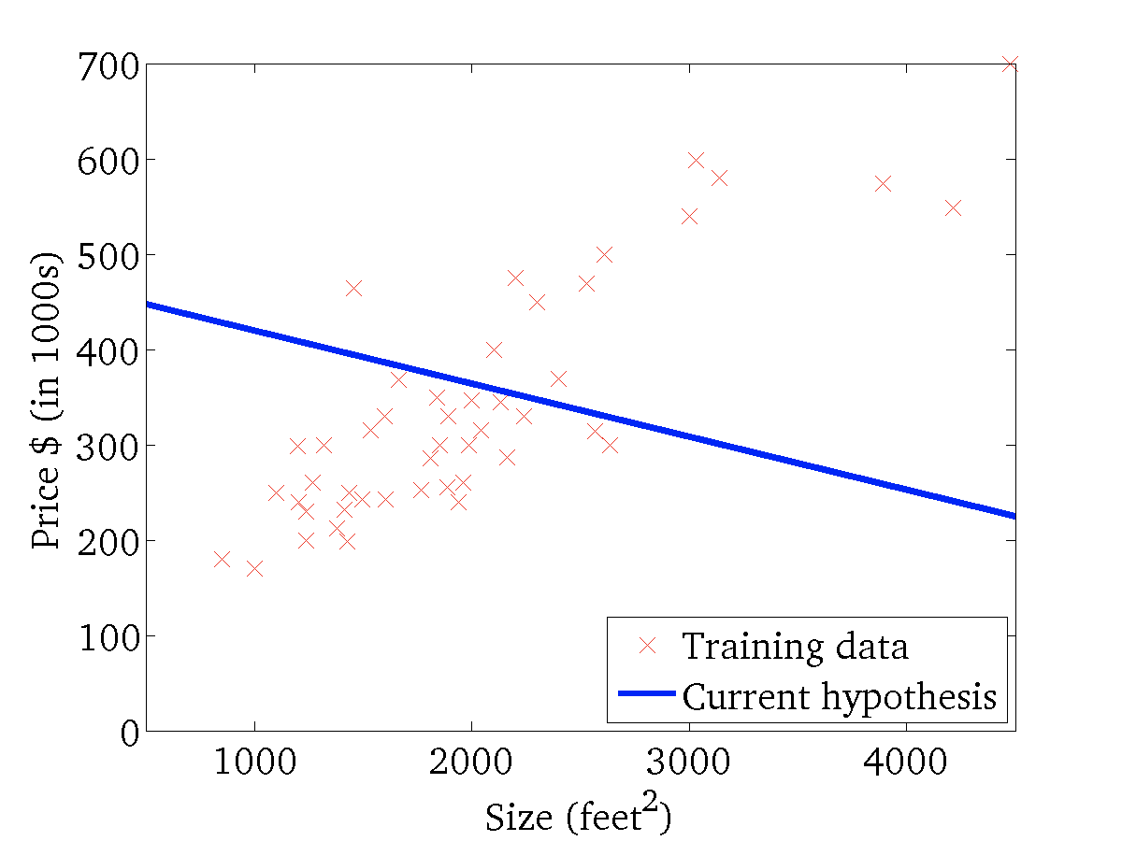

LMS update rule

Slide 22
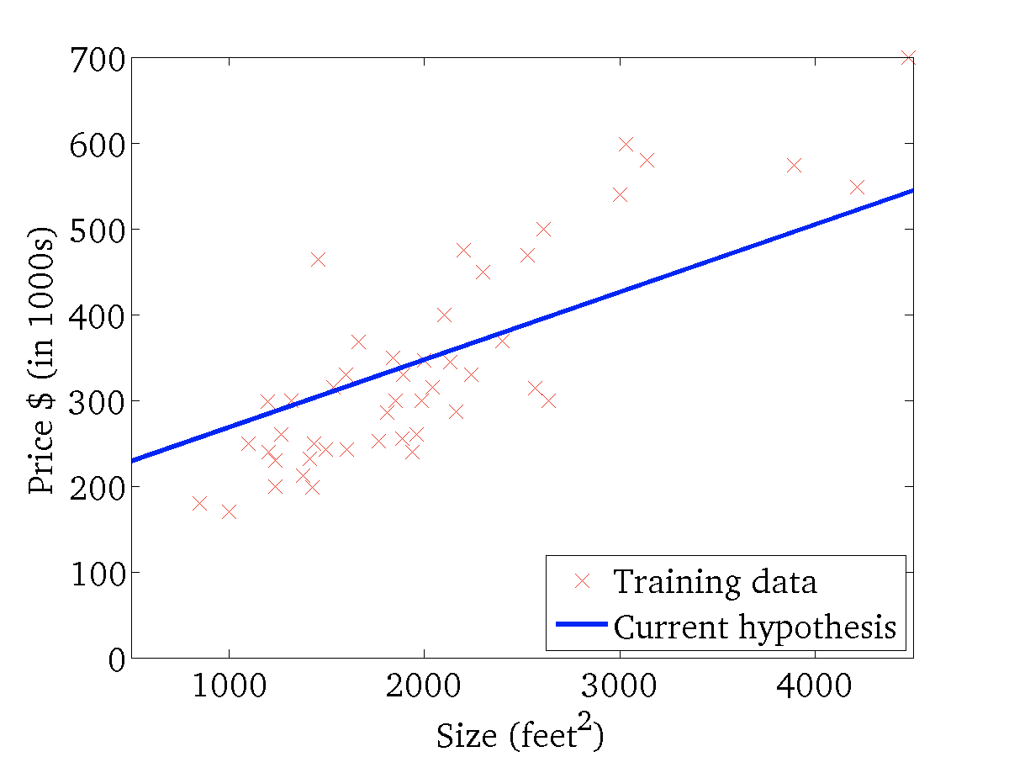

LMS update rule

Slide 23
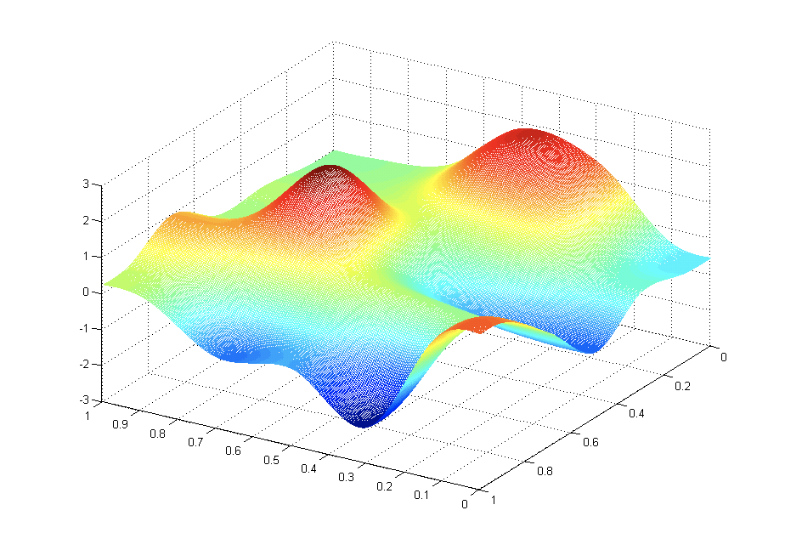
Gradient Descent
Have some function J(θ_{0,} θ₁)
Want min_{θ0, θ1} J(θ_{0,} θ₁)
Outline:
Start with some (θ_{0,} θ₁), could be random values or just (0,0)
Keep changing (θ_{0,} θ₁) to reduce J(θ_{0,} θ₁) until we hopefully end up with at a minimum
J(θ_{0,} θ₁)
θ₀
θ₁

Slide 24
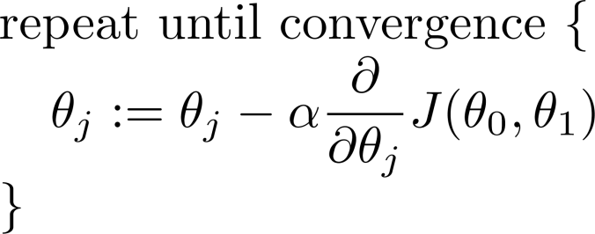
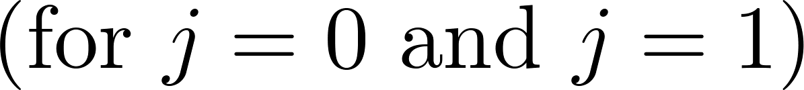
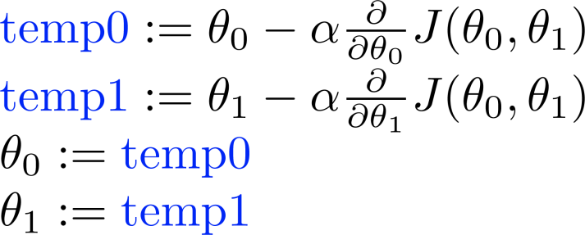
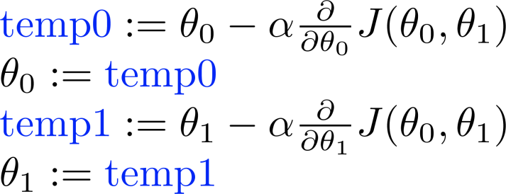
Gradient Descent
Correct: Simultaneous update
Incorrect:

Slide 25
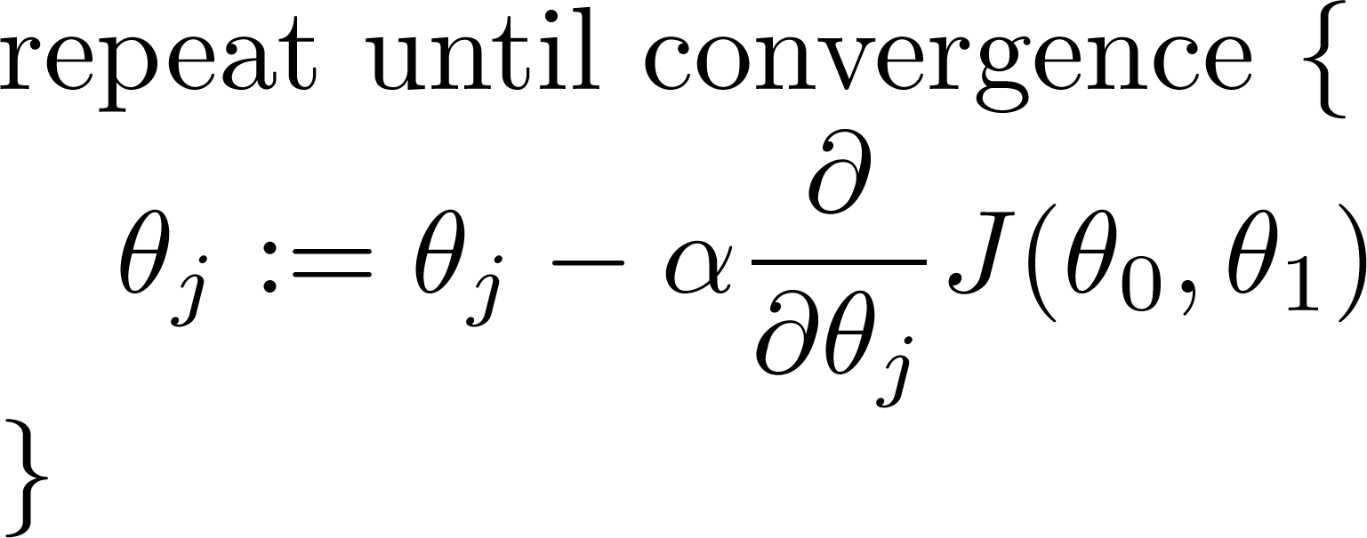
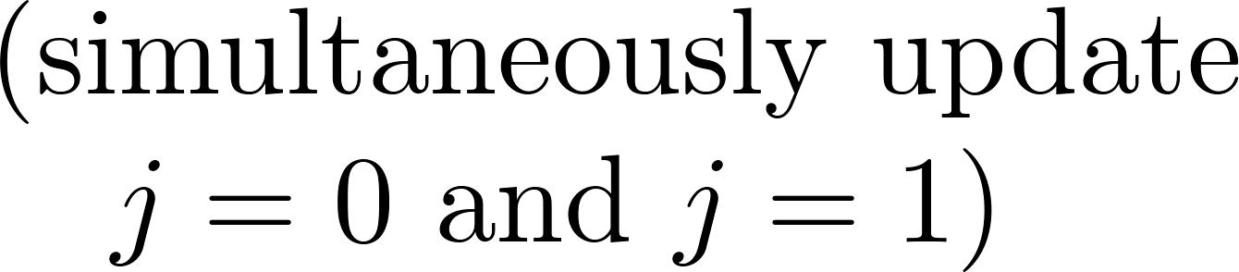
Gradient Descent
J(θ₁)
Learning rate
Derivative
⛛J(θ₁)
If α is too small, gradient descent can be slow.
If α is too large, gradient descent can overshoot the minimum. It may fail to converge, or even diverge.
minimum: ⛛J(θ₁)=0

Slide 26
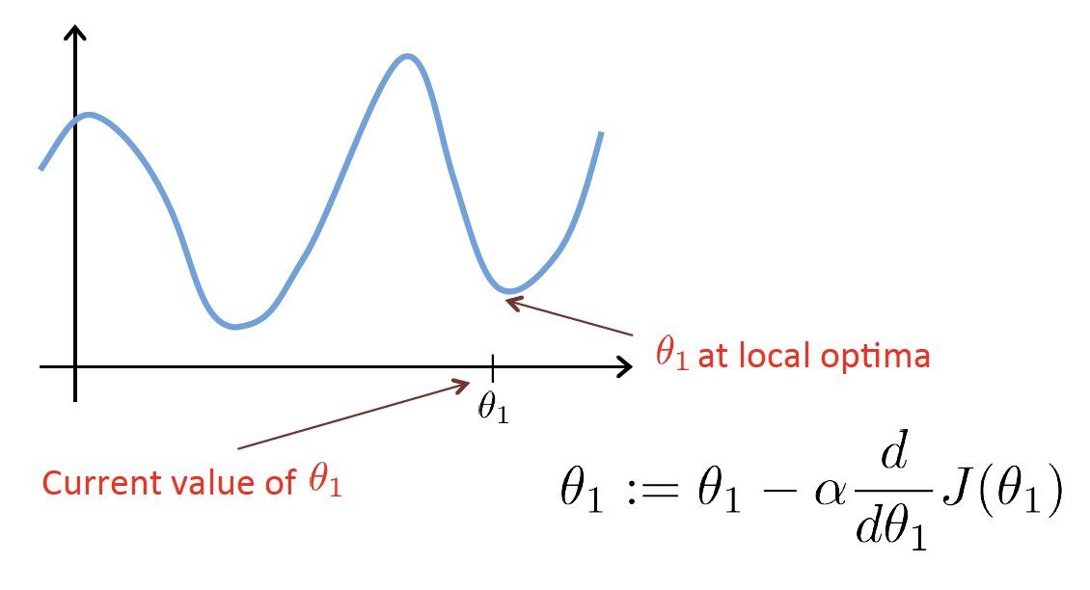
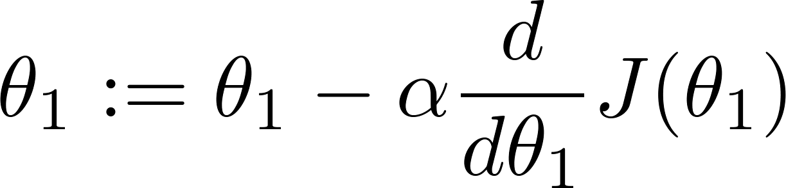
Gradient Descent
Gradient descent can converge to a local minimum, even with the learning rate α fixed.
As we approach a local minimum, gradient descent will automatically take smaller steps. So, no need to decrease α over time.

Slide 27
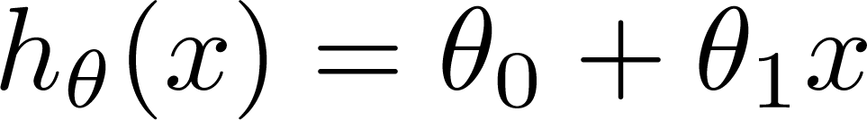
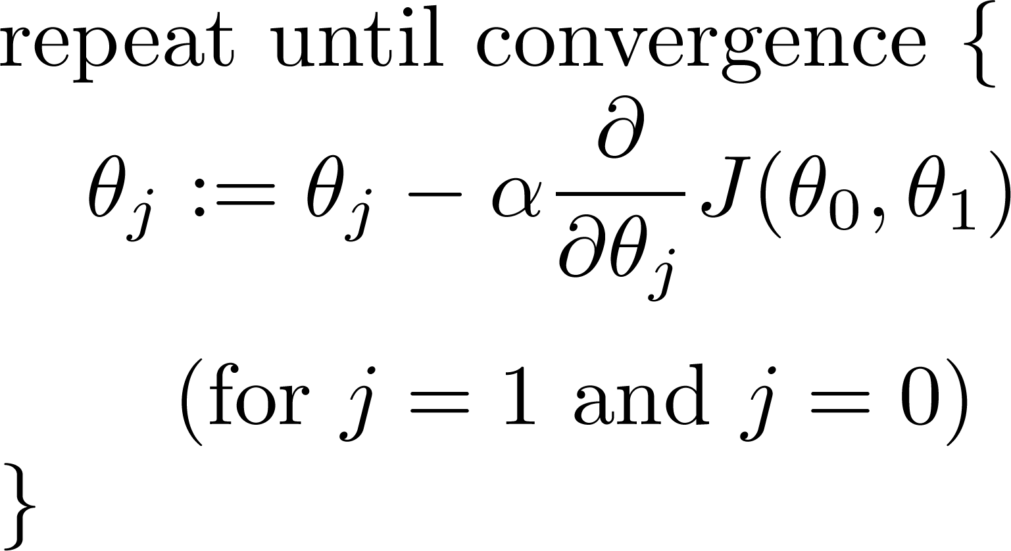
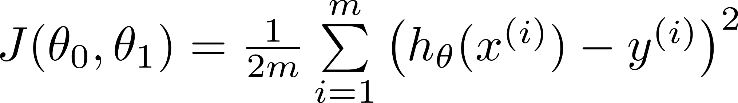
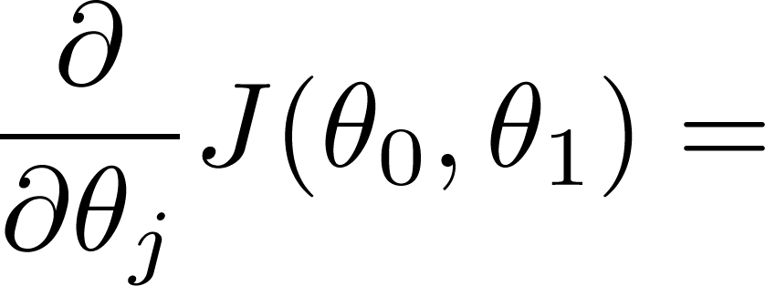
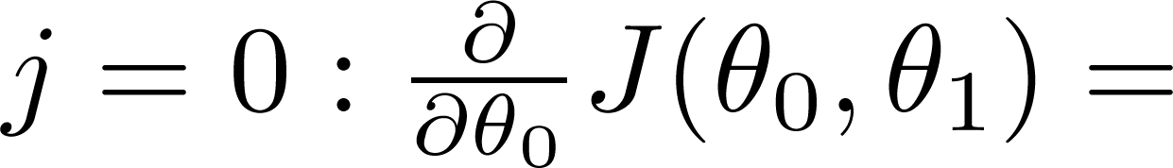
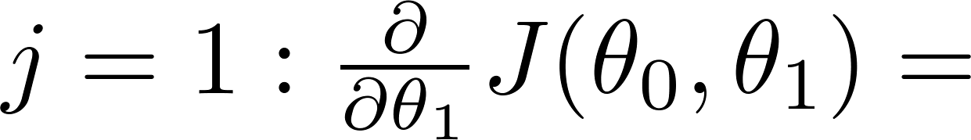
Gradient Descent for Linear regression
Linear Regression Model
Gradient Descent

Slide 28
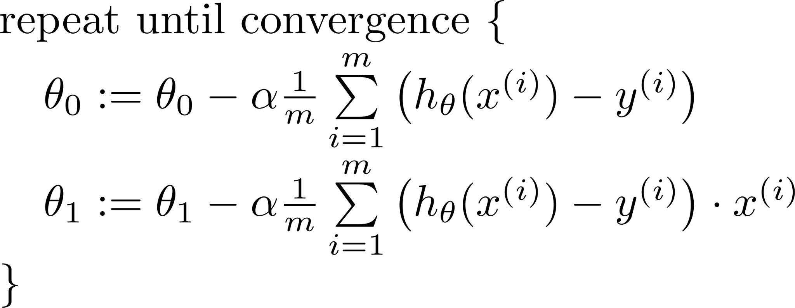
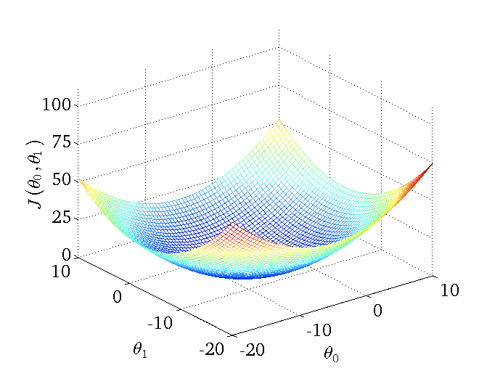
Gradient Descent Algorithm
Simultaneous update
J(θ_{0,} θ₁)
θ₀
θ₁
Notes:
Convex function.

Slide 29

Gradient Descent Algorithm

Slide 30
Batch Gradient Descent
“Batch”: each step of gradient descent uses all the training examples.
m = all the data.

Slide 31
Multiple Feature Linear Regression

Slide 32
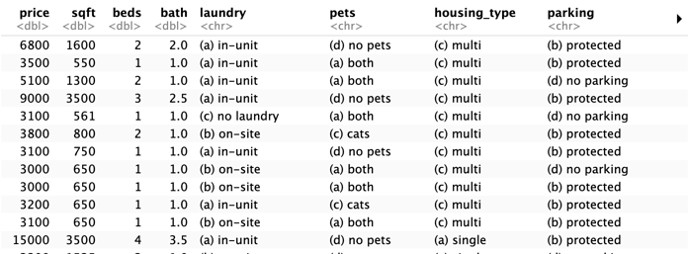
Multiple Features (Variables)
Notation:
n = number of features
x^{(i)} = input (features) of i^{th} training example
x_{j}^{(i)} = value of features j of i^{th} training example
y
x₁
x₂
x₃
x₄
x₅
x₆
x₇

Slide 33
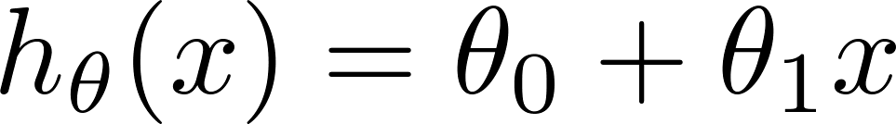
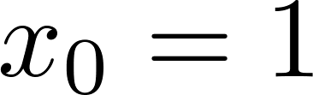
Hypothesis
Previously:
What is the multiple variables one?
For convenience of notation, define
Multivariate linear regression.

Slide 34
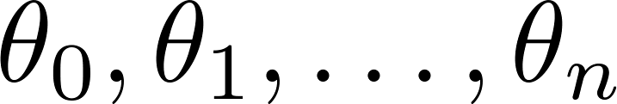
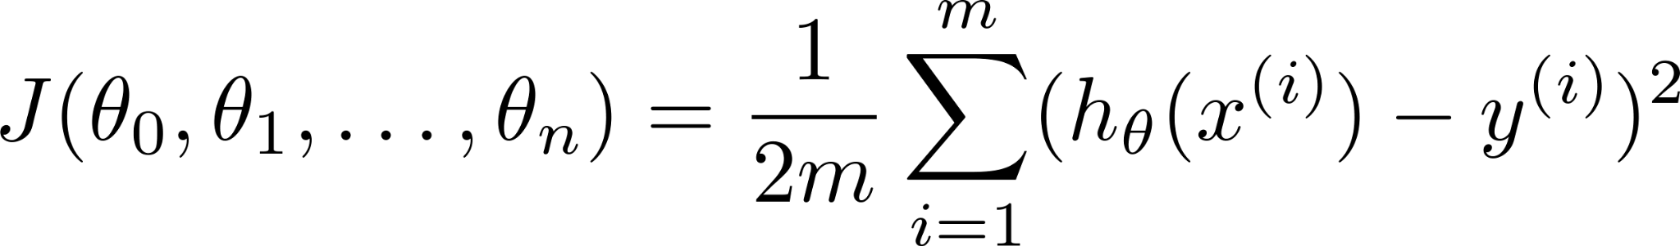
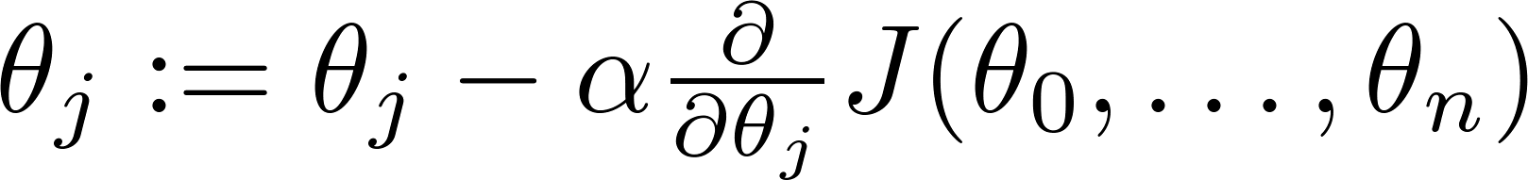
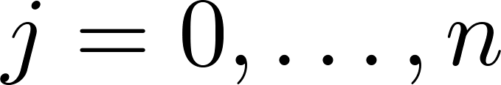
Gradient Descent for Multivariate linear regression
Hypothesis:
Parameters:
Cost function:
Gradient descent:
Repeat:
Simultaneously update for every
J(θ)
J(θ)

Slide 35
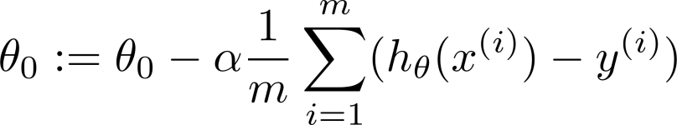
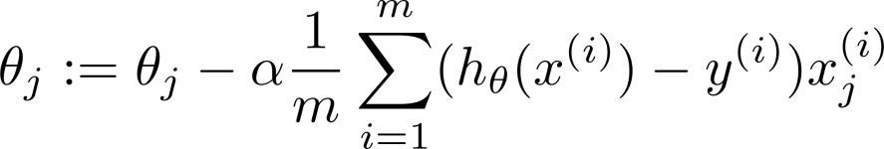
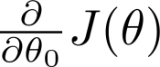
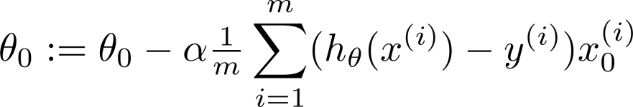



Gradient Descent
n=1: repeat
n>1: repeat
Simultaneously update θ_{0,} θ₁
Simultaneously update all θ’s

Slide 36
Features

Slide 37




Feature Scaling
Size: range 0-3500
Number of bedrooms: 0-5
Idea: make sure features are on a similar scale.
Mean Normalization: Replace x_{i} with (x_{i} - μ_{i} / range)
Standardization: statistic
Notes:
X - mean will make features have approximately zero mean (not x0=1)

Slide 38
Polynomial Regression

Slide 39

Polynomial Regression
Will this still linear?
What about the following?

Slide 40
Normal Equation

Slide 41




Normal Equation
Normal equation is a method to solve for θ analytically.
Set
Solve
1 | 1600 | 2 | 2
1 | 550 | 1 | 1
1 | 1300 | 2 | 1
6800
3500
5100
X =
y =

Slide 42

Gradient Descent vs. Normal Equation
Gradient Descent
Need choose learning rate
Needs many iterations
Works well even when feature size is large
Normal Equation
No need learning rate
No iteration
Need to compute
Slow if feature size is very large
If m << n, non-invertible (singular/degenerate), need to do feature deletion or regularization.
m: sample size, n: feature size
Notes:
Computation for Normal equation is O^3

Slide 43
Logistic Regression

Slide 44



Classification
Email: spam vs. not spam
Online: transaction vs. fraudulent
Tumor: malignant vs. benign
Want h(x) ∈ [0,1].
Logistic Function:

Slide 45




Logistic Regression
Threshold classifier output h_{θ}(x) at 0.5.
If h_{θ}(x) >= 0.5, predict “y=1”
If h_{θ}(x) > 0.5, predict “y=0”
Sigmoid function = Logistic function
How do we interpret h_{θ}(x)?
Tell patient that 70% chance of tumor being malignant
Positive
Cutoff
Negative

Slide 46
Logistic Regression
P(y = 1 | x;θ) = h_{θ}(x)
P(y = 0 | x;θ) = 1 - h_{θ}(x)
“Probability that y=1, give x, parameterized by θ”
What is the h(x) function?
z = 0:
z → ∞:
z → -∞:

Slide 47


Logistic Regression
If we define h function as:
Logistic regression algo is actually to learn what values for coefficients allow a decision boundary.
Can you find 3 values that allow we can make a decision boundary between the two labels?
Notes:
Answer is [-3, 1, 1]

Slide 48





Non-linear Decision Boundaries
Predict if
What other similar formula you can think of? Make sure they are ‘linear’.

Slide 49



Cost Function of Logistic Regression
Training data:
How to choose the parameters?

Slide 50





Cost Function of Logistic Regression
Linear regression cost function:
Logistic regression cost function:

Slide 51
Cost Function of Logistic Regression

Slide 52
Cost Function of Logistic Regression

Slide 53





Simplified Cost Function and Gradient Descent
To fit parameters ፀ:
Gradient descent:
Want
Repeat
To make a prediction given new x.
Output:
(simultaneously update all ፀ)
Algorithm looks identical to linear regression!

Slide 54
Advanced Optimization
Optimization algorithms:
Gradient descent
Conjugate gradient
BFGS
L-BFGS
Advantages:
No need to manually pick learning rate
Often faster than gradientdescent.
Disadvantages:
More complex

Slide 55

Logistic Regression: Multi-class
What do you think we should do?

Slide 56


Logistic Regression: Multi-class
One-vs-all:
Train a logistic regression classifier for each class i to predict the probability that y=i.
On a new input x, to make a prediction, pick the class i that maximizes

Slide 57
Model Fitting and Diagnosis

Slide 58
Measuring Success
Regression Metrics:
Error: Difference between predicted and actual value.
Classification:
True Positive: Correctly identified as relevant
True Negative: Correctly identified as not relevant
False Positive: Incorrectly labeled as relevant
False Negative: Incorrectly labeled as not relevant

Slide 59






Example: Image Classification (Identify Cats)
Prediction:
Image:
True
Positive
True
Negative
False
Negative
False
Positive
Images from the STL-10 dataset

Slide 60

Precision, Recall, and Accuracy
Precision
Percentage of positive labels that are correct
Precision = (# true positives) / (# true positives + # false positives)
Recall
Percentage of positive examples that are correctly labeled
Recall = (# true positives) / (# true positives + # false negatives)
Accuracy
Percentage of correct labels
Accuracy = (# true positives + # true negatives) / (# of samples)
Confusion Matrix
Notes:
Oftentimes, accuracy is mistakenly used as the only metric for the quality of a model.
Unfortunately, using accuracy is misleading when there are very few true positives.
For example consider a dataset with 3 cats and 97 non-cats.
A model that predicts not-cat for each image would have an accuracy of 97% even though it is obviously not effective
In the cat example, precision is the number of correctly labeled cats divided by the number of times the model predicts cat
In the cat example, recall is the number of correctly labeled cats divided by the number of cat images

Slide 61


F1 Score
How to compare precision/recall numbers
 | Precision (P) | Recall (R)
Algo 1 | 0.5 | 0.4
Algo 2 | 0.7 | 0.2
Algo 3 | 0.02 | 1.0
Average
F1 Score

Slide 62


Sensitivity and Specificity

Slide 63

Put all together
Can you calculate these metrics?
Accuracy:
Precision:
Specificity:
Sensitivity:
FPR:

Slide 64

Receiver Operating Characteristic (ROC)
A ROC curve is a graph that shows the performance of a binary classifier, which is a model that classifies objects into two groups based on their features
Cutoff
Sensitivity
Random Classifier
1 - Specificity

Slide 65

Receiver Operating Characteristic
http://navan.name/roc/

Slide 66

Training and Test Data for Linear Regression
Training: Learn parameter ፀ from training data (minimizing training error J(ፀ))
Testing: assess the accuracy of model
Ration:
Train:test :: 70:30
Train:test :: 80:20
Why? If we don’t have test set,
what will happen?
Notes:
Overfitting

Slide 67



Overfitting
Fails to generalize to new examples not in training set.
How to make the model generalize? (Perform well or decent on new data)
Testing dataset: will be the judge when to stop training to prevent overfitting, but how can we evaluate the model?
Price for new x?
Training Epoch

Slide 68


Source of overfitting
Model too complex:

Slide 69

Address Overfitting
Options:
Reduce number of features.
Manually select features to keep.
Model selection algorithm (later in course).
Regularization (Will talk more later).
Keep all the features, but reduce magnitude/values of parameters.
We can added into the cost function so it will automatically do the job for us

Slide 70

Train:Validation:Test Set (Data is large enough)
Here testing is the final evaluation for the model.

Slide 71


Bias vs. Variance
Bias: expected difference between model’s prediction and truth
Variance: how much the model differs among training sets
Model Scenarios:
High Bias: Model makes inaccurate predictions on training data
High Variance: Model does not generalize to new datasets
Low Bias: Model makes accurate predictions on training data
Low Variance: Model generalizes to new datasets

Slide 72
Probability Review and Weighted Least Squares

Slide 73
Probability Review
We have already seen the linear regression model function:
Where did this model come from?
One way to view is via a probabilistic interpretation (helpful throughout the course).

Slide 74

Probability vs. Linear Regression
We make an assumption (common in statistics) that the data are generated according to some model (that may contain random choices). That is,
Here, ε^{(i)} is a random variable that captures “noise" that is, unmodeled effects, measurement errors, etc.
Please keep in mind: this is just a model! As they say, all models are wrong but some models are useful. This model has been shockingly useful.

Slide 75


Properties of Noise
Error follow a normal distribution:
ε~N(0, σ²)

Slide 76


Weighted Least Squares
The method of ordinary least squares assumes that there is constant variance in the errors (which is called homoscedasticity). The method of weighted least squares can be used when the ordinary least squares assumption of constant variance in the errors is violated (which is called heteroscedasticity).
If we define the reciprocal of each variance, σ_{i}² , as the weight, w_{i}=1/σ_{i}², then let matrix W be a diagonal matrix containing these weights:
Notes:
where
epsilon*
is assumed to be (multivariate) normally distributed with mean vector 0 and nonconstant variance-covariance matrix

Slide 77


Weighted Least Squares
Slide 42
𝚯=(X^{T}WX)⁻¹X^{T}Wy
Notes:
where
epsilon*
is assumed to be (multivariate) normally distributed with mean vector 0 and nonconstant variance-covariance matrix

Slide 78
Final Project

